Slide 1
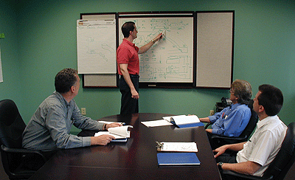
Strategic Project and Risk Management

Slide 2

Dr. Richard Scudder
Associate Dean, Graduate Studies, Daniels College of Business, University of Denver
Former professor and Chair, Information Technology and Electronic Commerce
Director, Business Intelligence Program
Adjunct Professor, Berkeley and Georgetown Universities
President, Scudder and Associates
Multiple Corporate Boards of Directors
Former CIO, University of Denver
Notes:
2

Slide 3
Today’s Agenda
Links between Program/project Management, Risk Management and Organizational Strategy
Portfolio Management Offices (PMOs)
Creating a Strategic Portfolio of Projects
Portfolio Architecture
Understanding Project Maturity
Creating and Managing Portfolios of Programs and Projects
  Portfolio methods
  Samples
  Methods and Dashboards
Creating Metrics for Managing Processes: Estimating

Slide 4
Tomorrow’s Agenda
Metrics for Managing Risk
  Tools for measurement
  Creating a Performance Measurement System
  Reporting Methods
The Process of Risk Management
Risk Planning and Management Tools
Program Risk Management

Slide 5

Strategic Project and Risk Management
Project management is no longer a series of isolated events
Projects critically impact most organizations – for good or bad
Projects must be viewed strategically to help focus the organization
Risk Management is a key component to project and organizational success

Slide 6
Competitive Trends
Rapidly changing competitive environment
Increased attention to supplier effectiveness
  Exploiting technology and the internet to improve performance
  Orchestrate the rhythms to enable delivery of projects and products

Slide 7
Project Chaos
29% of projects succeed
A 100% improvement from 1994
19% fail completely
Down from 31% in 1994
52% are challenged
$55 billion total project waste
Up from $38 billion in 2002
Standish Group, 2015

Slide 8
Project Chaos
Over the Years
Successful:
2011 – 29%
2012 – 27%
2013 - 31%
2014 – 28%
2015 – 29%
Challenged:
2011 – 49%
2012 – 56%
2013 – 50%
2014 – 55%
2015 – 52%
Failed:
2011 – 22%
2012 – 17%
2013 – 19%
2014 – 17%
2015 – 19%

Slide 9
Project Failure
Company | Project | Cost
Fox Meyer | SAP | Bankruptcy – $1,000,000,000
AMR | Booking System | $109,000,000
Norfolk Southern | Systems Integration | $113,000,000
Hershey | SAP ERP | $150,500,000
DIA | Airport | $ 4 billion
The Big Dig (Boston)
$14 Billion overrun
8 years behind

Slide 10
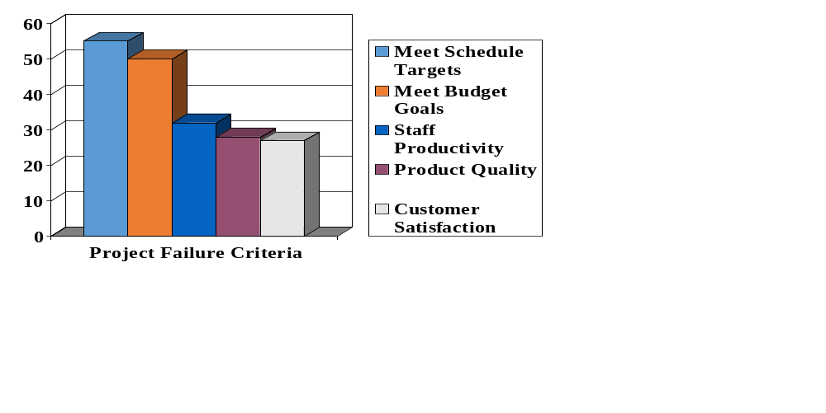
Failure Criteria
%
Source: Cutter Consortium, 2005

Slide 11
Traditional Project Management
Projects were done in a sequential (serial) manner.
Tasks were often simply passed from one group to another.
Functional groups worked autonomously.
The results:
  Frequent changes False starts, delays
  Cost escalation Project failures

Slide 12
Traditional Project Management
Problems often went undetected until it was too late.
Functional priorities took precedence, leaving project tasks to be done ‘later.’
As the project deteriorated, finger pointing escalated and communication deteriorated.
Only ‘heroes’ triumphed.

Slide 13
Traditional Project Management
Project success is most influenced early in the project.
But the downstream, functional focus leads to paying attention too late.
Probability of Success
Project Lifecycle
(Time)
Involvement
Influence
Notes:
Why did it take so long for Project Management to become accepted? It has been around since the pyramids.
Historically PM was used in tech orgs – R&D. engineering, MIS. Organizations accepted it when these were significant profit and loss centers.
The economy was another drive
Good – not needed
Bad – becomes critical

Slide 14
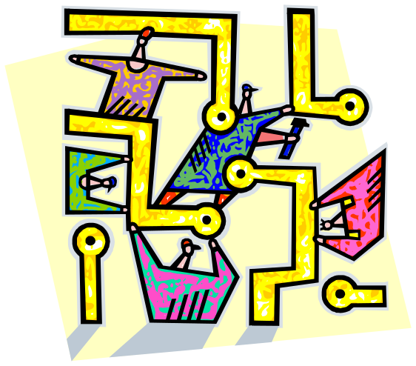
EFFECTIVE
PROCESS MANAGEMENT
IS CRITICAL

Slide 15


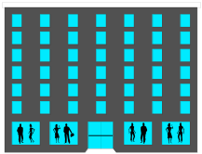
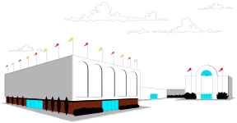

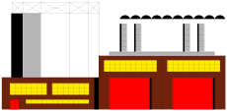
© 2001 Edward G. Lewis
GLOBAL VALUE CHAIN
LINKING THE GLOBAL VIRTUAL ENTERPRISE
SYNCHRONIZED CONSUMER RESPONSE
Timely, Accurate & Continuous Flow of Product/Service, Information & Money
Planning & Execution Processes
Supplier Manufacturer Distributor Retailer Retail Store Consumer
Supply Chain Front & Back Office Integration Demand Chain
DIRECT LINKAGE OF YOUR PRODUCT/SERVICE-DELIVERY PROCESSES
TO THOSE OF YOUR CUSTOMERS & THEIR CUSTOMERS,
AND THOSE OF YOUR SUPPLIERS & THEIR SUPPLIERS
Notes:
15

Slide 16

Getting to a Global Strategy
Know what value your organization brings to the world.
Structure your projects’ portfolio to support and add to that strategy.
Measure how you are doing.

Slide 17
Know What Value
You Bring
Consider the world with your organization versus without it.
  If your organization were shuttered, to whom would it matter and to whom would it not?
  Which of your clients would miss you the most and why?
  How long would it take for another organization to step into the void?
Brandenburger and Nalebuff: “Co-opetition”
Notes:
Purpose should be at the heart of strategy. It should give direction to every part of the firm – from the corporate office to the loading dock – and define the nature of the work that must be done.
In “Unleashing the Power of Learning,” a 1997 interview with HBR, John Browne, then the CEO of British Petroleum, put it this way:
“A business has to have a clear purpose. If the purpose is not crystal clear, people in the business will not understand what kind of knowledge is critical and what they have to learn in order to improve Performance
.… What do we mean by purpose? Our purpose is who we are and what makes us distinctive. It’s what we as a company exist to achieve, and what we’re willing and not willing to do to achieve it.”
The most viable statements of purpose are easy to grasp and true to a company’s distinctiveness. Pixar, one of the world’s most innovative animation firms, says that it exists “to combine proprietary technology and world-class creative talent to develop computer-animated feature films with memorable characters and heartwarming stories that appeal to audiences of all ages.” No films for mature audiences only. Lots of pushing the envelope. And who wouldn’t recognize IKEA’s intent to offer customers “a wide range of well-designed, functional home furnishing products at prices so low that as many people as possible will be able to afford them”? Sitting at the hub of the strategy wheel, purpose aligns all the functional pieces and draws the company into a logically consistent whole. Well understood, it serves as both a constraint on activity and a guide to behavior. As Michael Porter has argued, an effective strategy says not only what a firm will do but also, implicitly, what it will not do.

Slide 18
Strategy
The Prevailing Approach: Strategy as a Set Solution |  | What Is Missing: Strategy as a Dynamic Process
A long-term sustainable competitive advantage | Goal | Creation of value
The CEO and strategy consultants | Leadership | CEO as chief strategist; the job cannot be outsourced
Unchanging plan that derives from an analytical, left-brain exercise | Form | Organic process that is adaptive, holistic, and open-ended
Intense period of formulation followed by prolonged period of implementation | Time Frame | Everyday, continuous, unending
Defending an established strategy through time | Ongoing Activity | Everyday, continuous, unending
Notes:
Competitive advantage is essential to strategy. But it is only part of a bigger story, one frame in a motion picture.
The very notion that there is a strategic holy grail – a strategy brilliantly conceived, carefully implemented, and valiantly
defended through time – is dangerous. It is akin to the complete-contract view, in which all the thinking is done at
the beginning and the key job of the strategist is to get that analysis right. If this were so, the role of the strategist would
be limited and easy to separate from the leadership of a firm. If this were so, the strategist wouldn’t have to be concerned
with how the organization gets from here to there – the execution challenge writ large – or how it will capitalize on the
learning it accumulates along the way.
But this is not so. Great firms – Toyota, Nike, and General Electric, to name a few – evolve and change. So do great
strategies. This is not to say that continuity has no value. It is not to say that great resources and great advantages aren’t
built over the long term. It is, however, to acknowledge that the world, both inside and outside the firm, changes not
only in big, discontinuous leaps but in frequent, smaller ones as well.
An ancient Greek legend provides a powerful metaphor for this process. According to the legend, the ship that the
hero Theseus sailed back to Athens after slaying the Minotaur in Crete was rebuilt over time, plank by plank. As each
plank decayed, it was replaced by another, until every plank in the ship had been changed. Was it then still the same
ship? If not, at what point – with which plank – did the ship’s identity shift?
This metaphor captures the evolution of most companies. Corporate identities are changed not only by cataclysmic
restructurings and grand pronouncements but also by decision after decision, year after year, captain after captain.
An organic conception of strategy recognizes that whatever constitutes strategic advantage will eventually change. It
recognizes the difference between defending a firm’s added value as established at any given moment and ensuring that
a firm is adding value over time. Holding too strongly to one competitive advantage or one purpose may result in
the firm’s being controlled by a perception of value long after that value has diminished in significance. It encourages
managers to see their strategies as set in concrete and, when spotting trouble ahead, to go into defensive mode, hunkering
down and protecting the status quo.
Apple Computer was caught in this trap for most of the 1990s. The company stubbornly stuck to its original strategy
of producing high-end differentiated personal computers, convinced that it was adding value even as the intensely
competitive marketplace told it otherwise. By the summer of 1997 Apple’s share price was at a 10-year low, its market
share had plummeted to about 3%, and industry pundits were trumpeting the company’s demise. The strategy had
performed so poorly that there was little left to defend. Only after Steve Jobs returned as CEO, reclaimed the best of what
Apple once was (a passionate design company that believed technology could change the world), and took the firm into
new businesses (digital audio players, cell phones, and retailing) with distinctive products did the company attract
a new mass of passionately loyal customers and generate handsome returns. Plank by plank the company changed
its identity while remaining in many respects the same. Fittingly, in January 2007 it dropped “Computer” from its name
and became simply Apple Inc.
The need to create and re-create reasons for a company’s continued existence sets the strategist apart from every other
individual in the company. He or she must keep one eye on how the company is currently adding value and the other
eye on changes, both inside and outside the company, that either threaten its position or present some new opportunity
for adding value. Guiding this never-ending process, bringing perspective to the midst of action and purpose to the
flow – not solving the strategy

Slide 19
Strategy and PPM
Strategic
Management
Project Portfolio Management
Risk Management
Process Management
Performance Management
External Analysis
External Risks
Metrics
Project Risks
Core Processes

Slide 20

Portfolio Support
Projects must support the strategy.
That can not be done if projects are looked at simply one-by-one.
Portfolio management is key.
Notes:
How-How analysis can be used to work through
the detailed implications posed by strategy implementation.
For instance, in a now famous Harvard
Business School case study, Michael Porter describes
how a US corporation, Skil, a power tools business,
tried to achieve a turnaround (or detergent) strategy.
This strategy had two main planks: refocusing distribution
channels and reducing Skil's cost base in an
attempt to become market leader. Implicitly, Skil management
worked out the logic of implementation
unconsciously using a "How-How' approach. The key
ingredients of this implementation strategy can now be
depicted through the How-How methodology (see
Figure 4). How-How can act as a very fruitful brainstorming
tool to encourage managers to think through
(in a progressive degree of detail) the implications of
the strategy.
Next, 'From-To' analysis is a simplified version of
the organizational paradigm, 1'2 or analysing 'how we
do things around here'. 'From-To" is perhaps a more
manager-friendly approach as it can be readily tailored
to managers' view of their world--and couched in
their terms (and thus not in more academic language).
'From-To' (or 'FT' analysis) focuses on some of the
key shifts which one is trying to achieve in progressing
a particular strategy implementation project. FT analysis
adds value through:
• Capturing in a much richer way the broader (and
sometimes less tangible) shifts implied by the project.
• Focusing not merely on concrete organizational outputs
but also shifts in processes.
• Analysing not merely 'where we want to be' but simultaneously
'where we are now'.
FT analysis can also be used to track progress in
both implementing strategic change generally, and in
progressing specific projects. One way of operationalising
this is to score different aspects of the From-To
on a 1-10 and then drawing up a profile of "where we
are now' vs future vision. This highlights key gaps (see
Figure 5

Slide 21

Measurement
Measure your strategy.
Measure your processes.
Measure your portfolio.

Slide 22
Strategic PM Roadmap
Effective Management
Processes
Portfolios
Programs
Projects
Defined Methods
Measure Results
Pilots
Baselines
Inputs
Management
Clients
Customers
Employees
Stakeholders
Measurement
Risks
KPIs
Metrics
Measurements
Estimates
Consensus

Slide 23
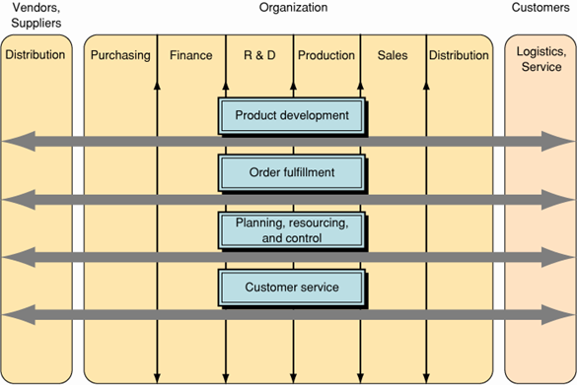
The Process
Focused Organization
Typical Network / Horizontal / Process Oriented Organization
Notes:
Let’s look at a process oriented organization structure - this is a simplified version of what some organizations are now using: it is
known as a network / horizontal or process oriented organization design
Typical attributes are shown on the right
Processes are shown explicitly
Important stakeholders (customers and vendors) are shown explicitly
Sometimes departments are still visible
Requires new attributes - ones which foster abilities to deal with an ever faster changing internet world
So, a process oriented organization is more likely to explicitly define its processes – which makes it more likely to reliably delivery and improve its value proposition.
Clearly today many organizations are a hybrid – but the leaders are increasingly moving towards greater and greater process orientation because of the pay-offs / benefits.
This creates an increasing demand for people who know how to analyze and design great high performing processes.

Slide 24
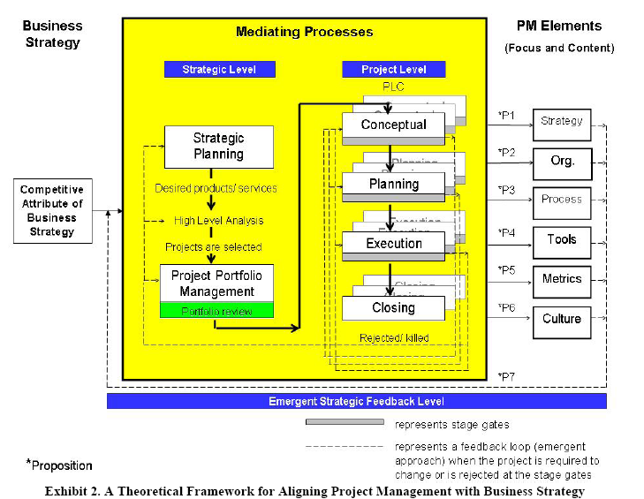
Strategy Alignment
Strong evidence suggests that the more clearly project and project portfolio management is tied to business strategy, the better the opportunity for success.

Slide 25
Organizational Performance
Organizations successful at narrowing the Performance Gap can experience performance gains of 25% or more!
Immediately following an organizational change, productivity drops as much as 3.6 hours a day (Dept. of Labor statistics)
Full Potential
Managed Change
Performance Gap
Performance/ Productivity
Actual Performance
Unmanaged Change
Major Organizational Change
Time

Slide 26
People and Organizational Performance
“At the end of the day, you bet on people, not on strategies.”
Larry Bossidy
“Strategy makes it possible, people make it happen.”
Unknown
“People…they’re trouble”
Former Boss

Slide 27
Dynamic Alignment
Strategy and people are synchronized with customer focus and process capabilities.
Creates great resilience and agility
Strategy
Processes
Customers
Adapted from: The Power of Alignment; George Labovitz and Victor Rosansky
People

Slide 28
Facts: Alignment
Only one in ten workers has a clear line of sight between his or her task and company goals.
40% of workers feel disconnected from their employers.
Despite management's best efforts to communicate business strategy, only 64 percent of employees think management has set a strategic direction.
Unclear objectives, lack of team communication and ineffective meetings are among the top time wasters. U.S. workers clock an average of 45 hours per week, but consider that 16 of those hours are wasted.

Slide 29
Closing the Performance Gap:
Organizational Alignment & Engagement
“Having the right people in the right places highly engaged in doing the right things right”
Strategic & OperationalElements
Human Elements
Setting Direction
Vision/Mission
Values
Objectives
Strategy
Priorities
Key Programs
Resource Allocation
Goals/Metrics
Organizational Design
Structure
Roles & Responsibilities
Competencies
Mgmt Process
Governance
Incentives/ Rewards
Culture
Engagement
Leadership
Team Effectiveness
Commitment
Motivation
Communication
Involvement
Trust/Respect
Notes:
Stakeholder analysis is the systematic identification
of key stakeholders and appraisal of their influence on,
and posture towards implementation. It may also
involve creating a strategy to reshape the influence of
these or new stakeholders.
Stakeholder analysis is our second type of organizational
radar which helps guide strategy implementation
projects. The tool used is as follows:
• First, identify who you believe the key stakeholders
are at any phase of the process (the 'stakeholder
brainstorm').
• Second, evaluate whether these stakeholders have
high, medium or low influence on the issue in question.
(You need to abstract this from their influence
generally in the organization.l°)
• Third, evaluate whether at the current time they are
for the project, against it, or idling in 'neutral'.
The above gives a good 'first cut' of the pattern of
stakeholders. The cluster of stakeholders depicted on a
stakeholder grid (see Figure 7) should then be assessed
to see what the overall picture looks like, particularly:
• Is the project an easy bet?
• Or is it highlighting a long slog?
• Or, finally, does this seem like 'mission impossible'?
Following the first-cut analysis managers can then
move on to the next phase:
• First, can new stakeholders be brought into play to
shift the balance or can existing players be withdrawn
in some way (or be subtly distracted)?
• Second, is it possible to boost the influence of stakeholders
who are currently in favour of the change?
• Third, is it possible to reduce the influence of antagonistic
stakeholders.
• Fourth, can coalitions of stakeholders in favour be
achieved so as to strengthen their combined influence?
• Fifth, can coalitions of stakeholders antagonistic to
the project be prevented?
• Sixth, can the change itself, in appearance or in substance,
be reformulated to diffuse hostility to the
project.
• Seventh, are there possibilities of 'bringing on
board' negative stakeholders by allowing them a
role or in incorporating one or more of their prized
ideas?
• Eighth, is the pattern of influence of stakeholders
sufficiently hostile for the project to warrant re-definition
of the project?
An example of stakeholder analysis in use is contained
in Figure 8. This is again based on the position
as assessed by internal managers of key stakeholders
at Dowty Communications.
Stakeholder analysis can invite as many questions as
it yields answers. These questions can be used by managers
to track potential positions of stakeholders (and
their agendas) in specific meetings and chance conversations.
Often a particular stakeholder may be difficult
to position. This may be because his/her agendas
might be complex. It is quite common to find that it is
only one specific blocker which has made a stakeholder
into an influential antagonist.
Where there are very large numbers of stakeholders
at play on a particular issue, this may invite simplification
or even dissolution or re-formulation of the project.

Slide 30
Career Best &
Worst Exercise
Pair-up with the person next to you.
Discuss the following:
  How well does your organization align projects and strategy
  How about “career worst”?
    What were the characteristics that made them a negative experience?

Slide 31
Key Tools to Link Strategy and Projects
Clear organizational strategy
  Designed and supported by all top managers
  Agreed to by customers, employees, all other relevant stakeholders
Portfolio Management Process
  Set up a Portfolio Management Office (PMO)
Stage Gates
Cascading organizational strategies, objectives, goals, strategies and measures

Slide 32
Relevance to Project Success
Topic | Highly relevant | Topic | Highly relevant
Governance | 20% | Value Management | 60%
Marketing & Sales | 29% | KPIs | 63%
Value Engineering | 36% | Conflict Management | 63%
Technology Management | 43% | Scope | 65%
Portfolio Management | 45% | Negotiation | 65%
Benefits Management | 45% | Finance | 66%
Knowledge Management | 47% | Estimating | 70%
Program management | 49% | Requirements | 72%
Quality Management | 56% | Business Case | 76%
Health, Safety & Environmental | 56% | Leadership | 77%
Procurement | 57% | Teamwork | 77%
Strategy | 58% | Risk & Opportunity | 81%
Stakeholder Management | 60% | Communication | 84%
Peter Morris, 2005 Global Congress Proceedings. Edinburgh, Scotland

Slide 33
The Flywheel and the Doom Loop
The Flywheel Effect
The Doom Loop
Steps Forward, Consistent with Vision/Direction
Disappointing Results
Reaction, Without Understanding
No Buildup; No Accumulated Momentum
Flywheel Builds Momentum
Accumulation of Visible Results
People Line Up, Energized By Results
New Direction, Program Leader, Event, Fad, or Acquisition
Source: “Good to Great” by Jim Collins

Slide 34
The Case for Using a Maturity Model
Whether recognized or not, most organizations go through a Project Management (PM) maturity process.
Recognizing where you are in your project maturity can help you organize to achieve higher levels of excellence.
Project maturity takes time; recognizing where you are and how long it takes to move forward can help smooth the process.
Notes:
34
Achieving success in project management excellence can take decades or years…it won’t happen overnight
HOWEVER, it cannot be achieved without change…it also requires extensive training.
The benefits today are obvious, for anyone that cares to look…it has become a competitive weapon that more and more companies are using to get and keep business.
During the past 30 years the PMI has grown from 3000 to 100000…it has become one of the icons of success and its certification programs are well embraced.
Aerospace, defense and large construction companies tend to have the highest levels of maturity. They have spent hundreds of millions to get there. They tend to create their own software and sell it to others. The automotive subcontractor, computer and electronics industries are now trying to emulate them. The mining and healthcare industries are behind them, but working towards higher levels of excellence.
The most rapid changes are now occurring in banking, pharmaceutical, oil and gas, and telecommunications industries.
The lagging industries include insurance, food, railroads/transportation, retail and beverages. They tend to be driven solely by schedule and quality concerns. Commodity manufacturing and the metals industries are barely aware of PM.

Slide 35
PM Maturity vs.
Crisis Management
Many organizations still function in a crisis mode.
Their competitors gain an Immediate Advantage if they choose to use project management tools and techniques.
In the long run, project management has become just as much of a tool as the telephone is.
The early adopters of PM are likely to be the survivors in any industry.
Even the early adopters must mature their PM processes, as more and more competitors start to use project management approaches.
Notes:
35

Slide 36
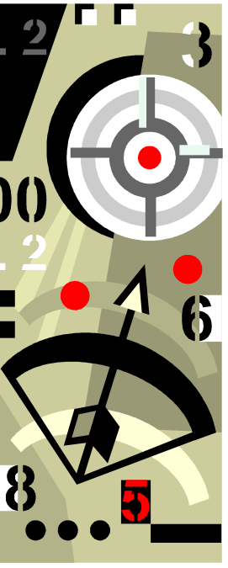
Why are Maturity
Models so popular?
Help firms compare competency levels
Help understand why some projects succeed and others fail
Proponents claim that higher maturity levels leverage competitive advantage
Notes:
36

Slide 37
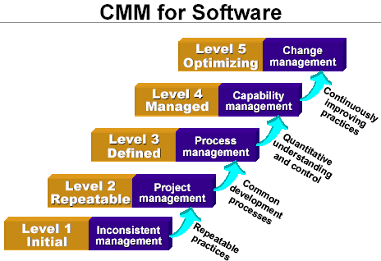
Capability Maturity Model (CMM)
Notes:
37

Slide 38
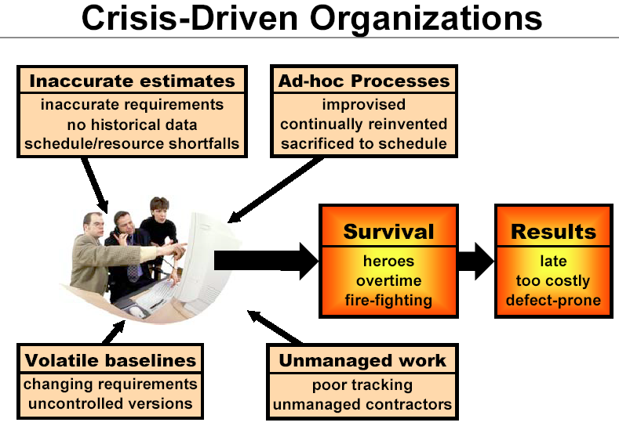
Notes:
38

Slide 39
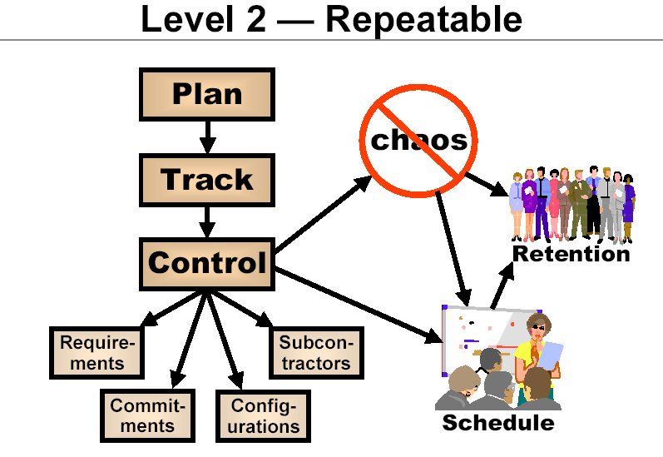
Notes:
39

Slide 40
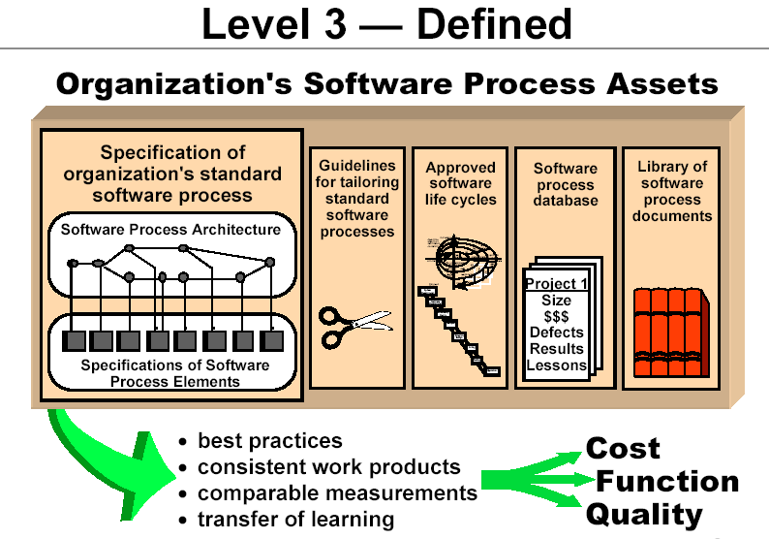
Notes:
40

Slide 41
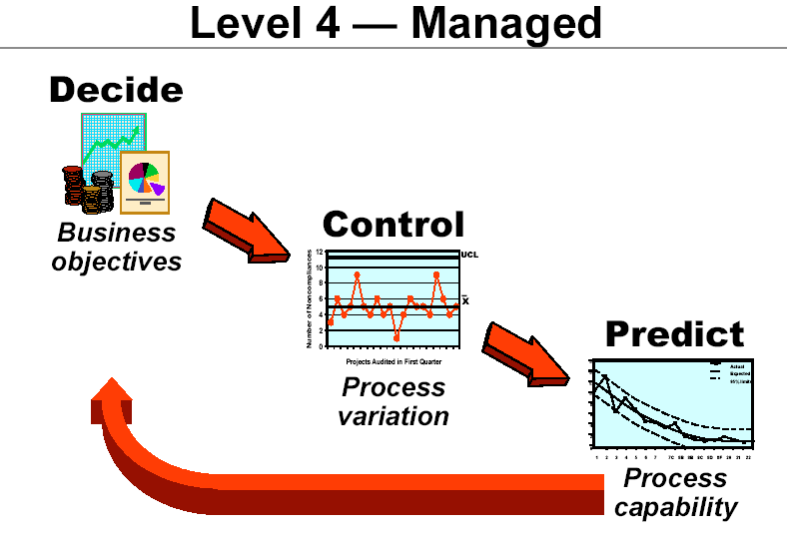
Notes:
41

Slide 42
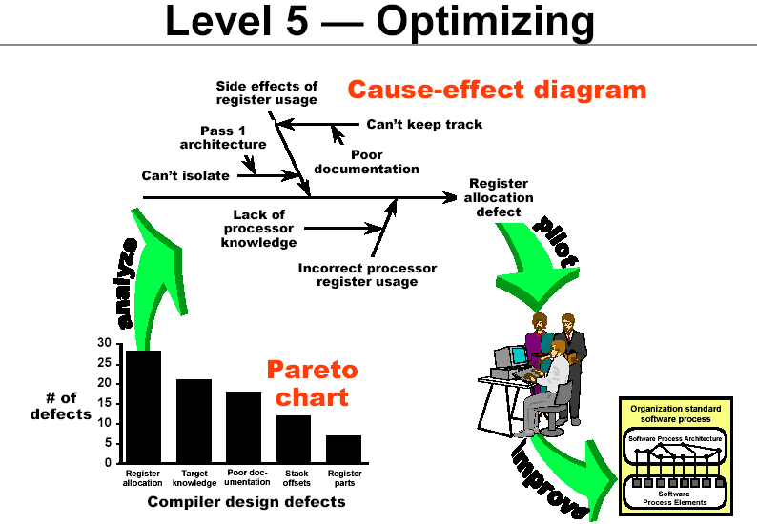
Notes:
42

Slide 43
Project Maturity Models
SEI-CMM is the basic (original) model
From The Software Engineering Institute (SEI) established in 1984 at Carnegie Mellon University (CMU), Pittsburgh
Principle customer is the Department of Defense
U.S. Air Force Project 1987
  Method to select software contractors
Over 5,000 Assessments performed since 1987
Notes:
43

Slide 44
What works?
Highly Successful Efforts
  Senior Mgt actively monitors SPI (Software Process Improvement) progress
  Clearly stated, well understood SPI goals
  Clear, compensated assignment of responsibility
  SEPG staffed by highly respected people
  Technical staff involved in improvement
Less Successful Efforts
  Organizational politics
  Turf guarding
  Cynicism from previous unsuccessful improvement efforts
  Belief that SPI “gets in the way of real work”
  Need more guidance on how to improve, not just what
“The Evidence for CMM-based Software Process Improvement” – SEMA-3.01, CMU, 2001
Notes:
44

Slide 45
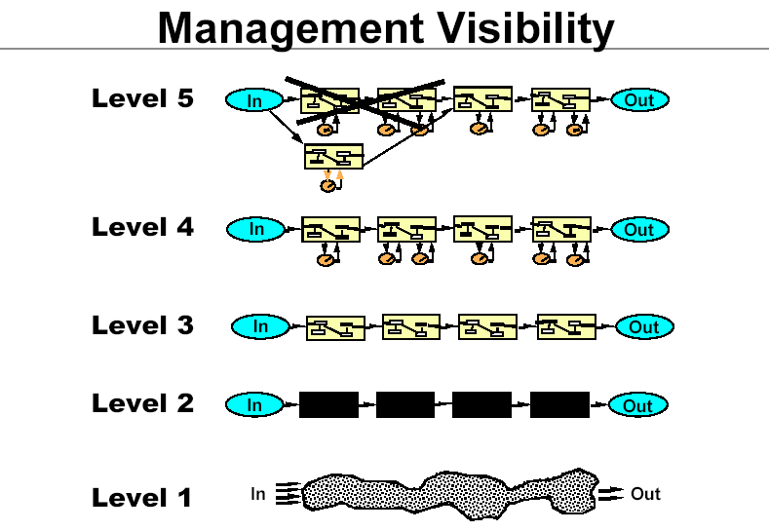
Notes:
45

Slide 46

Other Maturity Models
See the article “Assessing Organizational Capabilities: Reviewing and Guiding the Development of Maturity Grids” in your Workbook to Go
There are 120 and counting:
  Change proficiency MM
  Content management MM
  Customer intimacy MM
  Knowledge Management MM
  Organizational MM
  Product development MM
  Et cetera MM……………….
Notes:
46

Slide 47

PMI’s OPM3
Organizational Project Management Maturity Model
1998: Began building an international standard maturity model
End of 2003: Tested model released
The OPM is designed to be useful for all industries.
Notes:
47

Slide 48
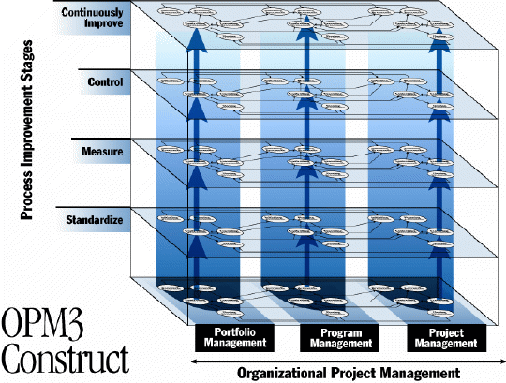
PMI OPM3
Increasing Maturity
Notes:
48

Slide 49
Management’s Role
Executive Maturity Must Precede Process Maturity
Continuously Improving Process
Optimizing
(5)
Managing
(5)
Need Management Program
Managed
(4)
Predictable Process
Participative
(4)
Need Executive Oversight
Standard, Consistent Process
Defined
(3)
Supportive
(3)
Need Consistency
Repeatable
(2)
Disciplined Procedures
Recognized
(2)
Ignored
(1)
Initial
(1)
From "Data Management Maturity Model" Burton G. Parker, et. al., MITRE Software Engineering Center, McLean, Virginia July 1995;
Parker, B., Enterprise-wide Data Management Process Maturity Framework, Handbook of Database Management, Auerbach, 1999
Notes:
49

Slide 50
Case Study
This first case study will be both an individual and a team activity. Use Case Study 1 for a rough assessment of your organizational project management maturity. After completing the assessment discuss the results with your team.

Slide 51
Strategic Relationship
Strategic
Projects
Project Delivery Systems
Capital
Projects
Enterprise Project Management
Product
Projects
Company
Strategic
Objectives
Operational
Projects
Notes:
51

Slide 52
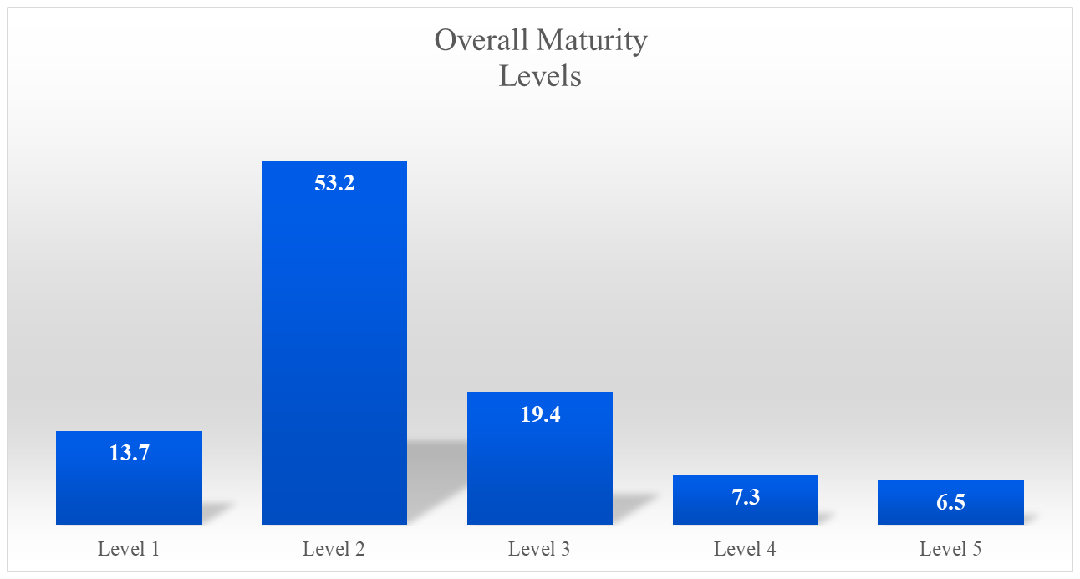
Overall Maturity
“Kwak and Ibbs: “Project Management Maturity: An Industry Benchmark”

Slide 53

Different Industries – Different Maturities
Most advanced:
  Engineering and construction
  Hi-Tech Manufacturing
  Telecommunications
  Defense Industries

Slide 54
Using Maturity Models
Understanding of current process management
Effective diagnosis of maturity levels
Portfolio and Project Complexity
Organizational commitment of time and resources
Support for knowledge management and transfer

Slide 55

Effective Project Management Costs
PM Cost as Percentage of Total Project Cost | Percentage of Companies Reporting This Level of Cost
0-1% | 15%
1.1 to 3% | 25%
3.1 TO 6% | 25%
6.1 to 10% | 15%
Above 10% | 20%
For organizations averaging level 3 project maturity
Generally higher in Engineering and Construction Projects
Ibbs: “Assessing Project Maturity

